Slide 1
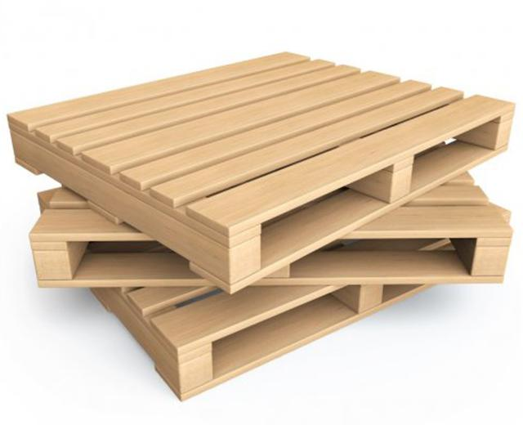

Optimization of Pallets in supply Chain Management

Slide 2

Project Leadership
Sharat Manikonda
Director at Innodatatics and Sponsor
linkedin.com/in/sharat-chandra

Slide 3
Team Members
Name:
https://www.linkedin.com/profilelink
Name: PADMAVATHY.D
https://www.linkedin.com/profilelink
Name:
https://www.linkedin.com/profilelink

Slide 4

Contents for allot and dehire
Project overview and scope
Business problem
Objective and constraints
CRISP-ML-(Q) Methodology
Technical Stacks
Project Architecture
Data collection and understanding
Data Information
Data Dictionary
Exploratory Data analysis
Insights for EDA
Data visualization
Notes:
Change

Slide 5

Project Overview and Scope
I
The goal of the project is to optimize the inventory of pallets based on plastic pallets and wooden pallets. In this way we can forecast the future with the past data Exploratory data analysis have to be used to achieve the goal. Tableau is used for data visualization.
The scope involves Data collection, Data preprocessing, EDA, rough sketch and Data visualization using tableau.

Slide 6

Business Problem
Reducing the number of pallets not being sold and returned by the customer

Slide 7
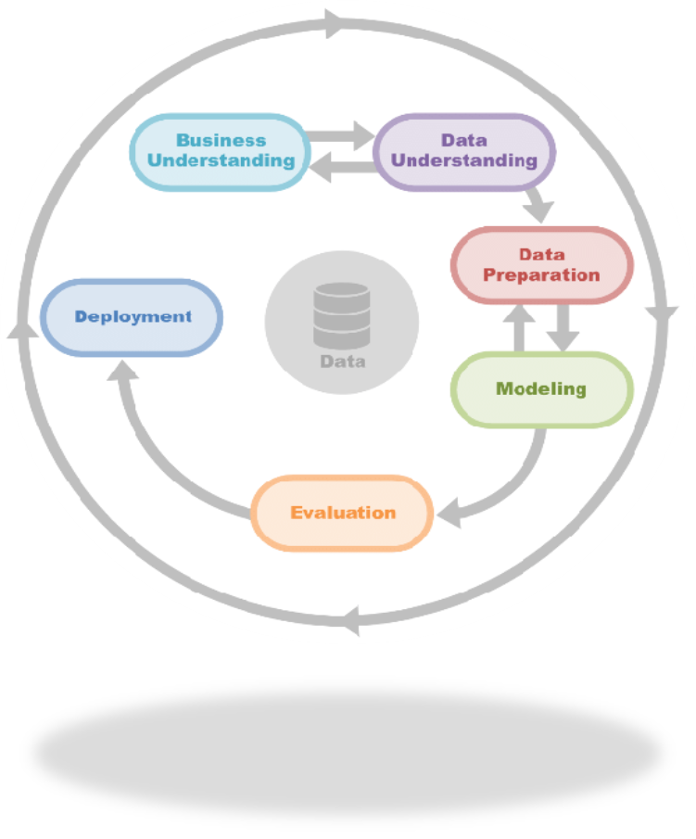
Constraints
Objective
To promote high standards in supply chain management production, quality assurance of the products
The preparation of wooden and plastic pallets according to the requirement of the customer.
Maximize the number of products manufactured and how many pallets are saled
Minimize and estimate the Number of orders being returned by customers upfront

Slide 8
CRISP-ML(Q) Methodology
1.Business Understanding: Business problem: Reducing the number of pallets not being sold and returned by the customer Business objective: Maximize the number of products manufactured and how many pallets are saled Business constraints: To promote high standards in supply chain management production, quality assurance of the products
Success Criteria: Integrate the EDA part and prepare the visualization through tableau and by forecasting we can optimize the inventory of future and past
Economic Success Criteria : Cost saving of 10-15% by effective analysis of pallets
2.Data Understanding: Collect and analyze data related to quantity of plastic pallets and wooden pallets and storage optimization 3.Data Preparation: Clean and preprocess data to remove missing values and outliers Transform data into a suitable format for modeling
4.Data visualization: Data visualization is viewed in tableau

Slide 9
Technical Stacks
Anaconda IDE: Jupyter
Database Management: MySQL
Python Libraries: NumPy, pandas, matplotlib, seaborn, sklearn, sweetviz, feature_engine , sqlalchemy, mysql and scipy
Data visualization:Tableau

Slide 10
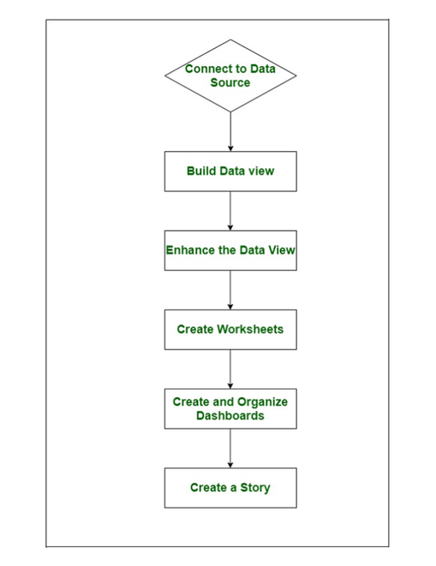
Project Architecture

Slide 11
Data Collection and Understanding
Data is provided by the client and it is a live data
The shape of the dataset for allot is (60174,48)
The shape of the dataset for Dehire is (39416,48)
Data pre-processing such as checking for duplicates, identifying missing values.
Data visualisation is done using tableau

Slide 12
Data Dictionary
Columns name | Description
DOCNUM | Document number of each purchase
POSTING DATE | Date of product imported for manufacturing
EFFECTIVE DATE | Date of product ready to be manufactured
CREATE DATE | Date of product manufactured
Customer/Vendor Code | Customer Code No.
Customer/Vendor Name | Customer Name
LOB | Commodity Name
Region | Each region
BP TYPE | Business Partner Type
City | City names
STATE | State names
From WhsCode | Warehouse code no. from
From WhsName | Warehouse name from
To whsCode | Warehouse code to
TO WhsName | Warehouse name to
Model TYPE | Type of Model

Slide 13
Data Dictionary
Transfer Type | Type of transfer
U_Frt | Unit fill rate - percentage of customer orders a company can fulfill without running out of inventory to fill customer orders
U_ActShipType | Means of Transport Shipping of product type
PRODUCT CATEGORY | Category of each product
ItemCode | Code of each items
Description | Description of products
QUANTITY | Quanity of products ordered/purchased
UNIT | No value in this column
RATE | Rate of the product
SO ID | Sale order ID
SO Creation Date | Sale Order Creation Date
SO Due Date | Sale Order Due Date
U_DocStatus | Document status of the purchase
NumAtCard | No value in this column
U_SOTYPE | Sale order type
BP CATEGORY | Business Partner Category
Document Type | Document type of the product
TRANSPORTER NAME | Name of the transporter name

Slide 14
Data Dictionary
Vehicle Type | Type of the vehicle
Direct Dispatch | Direct Dispatch of the product
Customer Invoice No | Customer Invoice No.
U_GRNNO | Good Received Note no of the product
Loading/Unloading | Loading and Unloading of the product
Business Heads | Name of the business Heads
KITITEM | Kit item numbers
Customer Type | Customer type of the product
U_TRINPD | Unable to describe. Currently the value appears has 0:00:00
FlowName | Flow name of the customer & State
POReference | Purchase order of the product

Slide 15
System Requirements
Operating system: Windows 10 or higher, macOS 10.14 or higher
Processor: Intel Core i3 or higher
Memory (RAM): 4 GB or higher
Storage: At least 250 GB free hard disk space
Software: Anaconda, MYSQL, tableau
Internet connection: Mobile internet connection with computer for accessing the internet

Slide 16
Data Information
The dataset tells about pallets in the warehouse and sales, returns and quantity from allot and dehire
The allot dataset consists of 60174 records and 48columns.
The dehire dataset consists of 39416 records and 48 columns.
Features involved in the dataset is mentioned below
Did Exploratory Data Analysis and the insights are documented
Done visualization using tableau.

Slide 17

Exploratory Data Analysis [EDA]
Data visualization: Using charts, graphs, histograms, and other visual tools to explore the data and identify patterns and trends for allot and dehire.
Summary statistics: Calculating descriptive statistics such as mean, median, mode, variance, and standard deviation to summarize the data.
Notes:
EDA is used for seeing what the data can tell us before the modeling task.
Change

Slide 18
EDA Description
EDA is a crucial step in the data analysis process where analysts examine and visualize the data to gain insights and understand the underlying patterns, trends, relationships, and anomalies in the data. EDA helps us to understand the data and identify potential problems or errors that may impact the accuracy and validity of the results.
EDA involves various techniques and tools such as data visualization, summary statistics, correlation analysis and data cleaning. The objective of EDA is to answer questions about the data and generate new questions that can be investigated using more advanced statistical techniques.

Slide 19
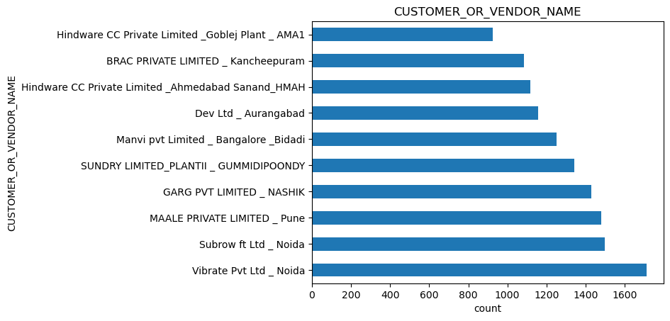
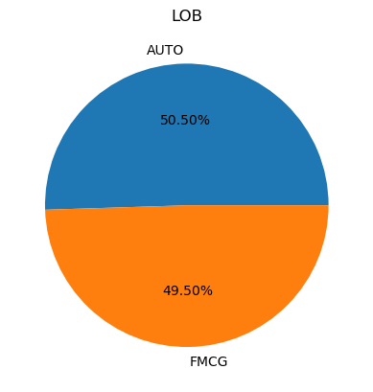
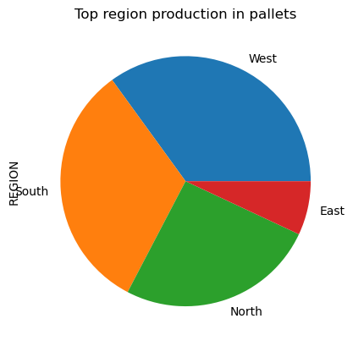
Data Visualization in EDA For allot
Notes:
Keep observations

Slide 20
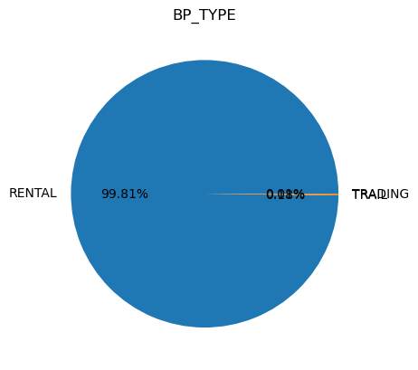
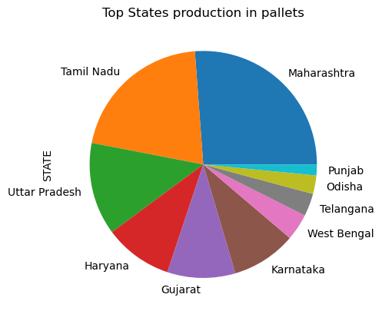
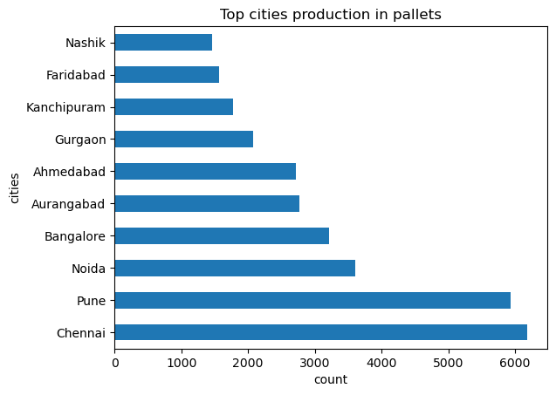
Data Visualization- EDA FOR ALLOT
Notes:
Add graphical

Slide 21
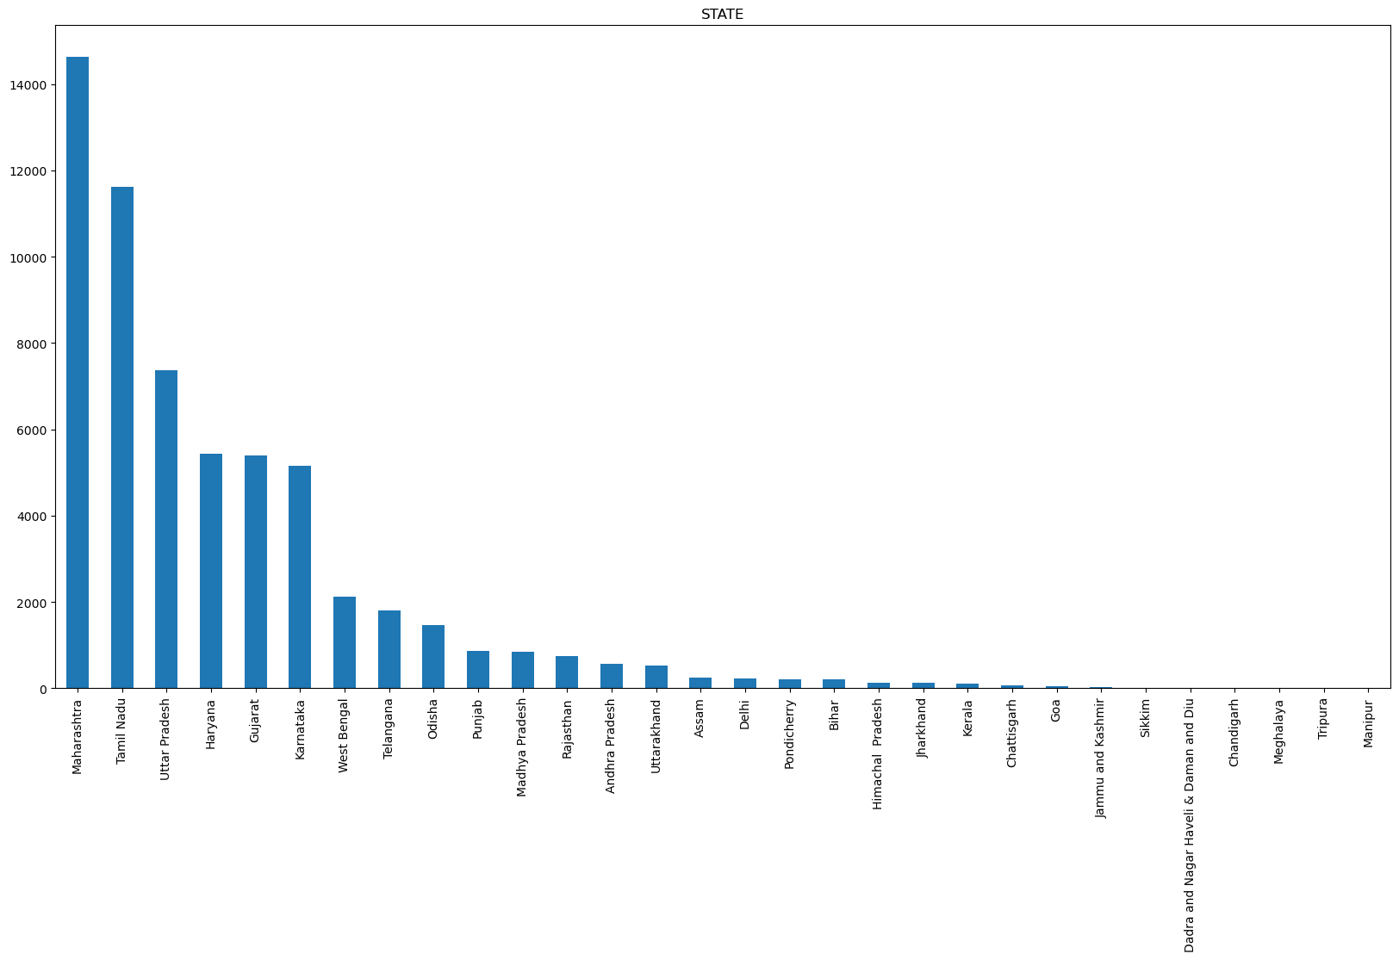
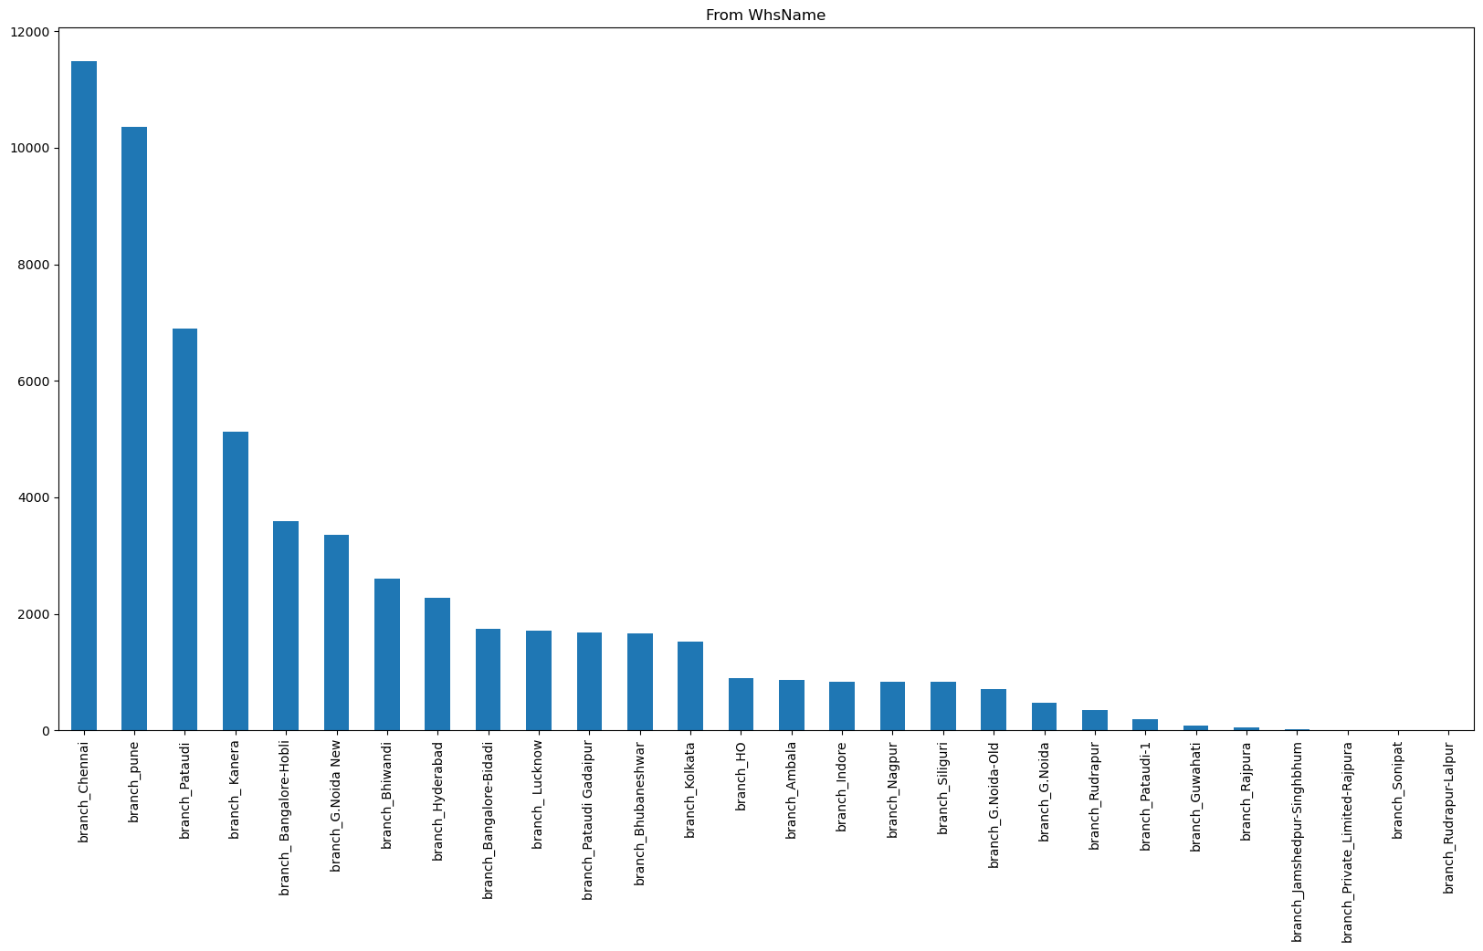
Data Visualization- EDA FOR ALLOT
Notes:
Piee

Slide 22
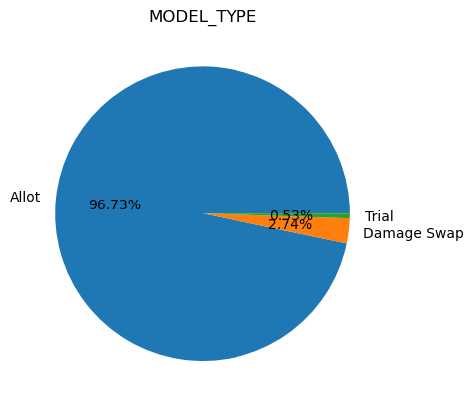
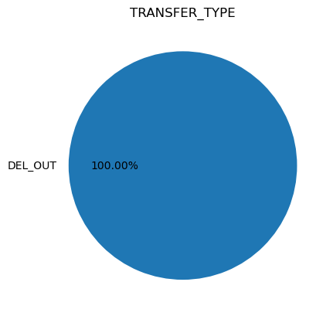
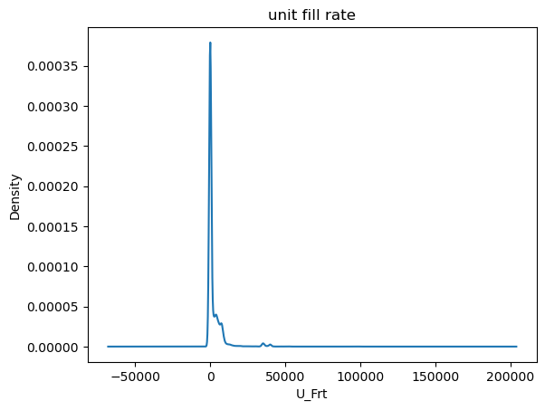
Data Visualization- EDA FOR ALLOT
Notes:
Piee

Slide 23
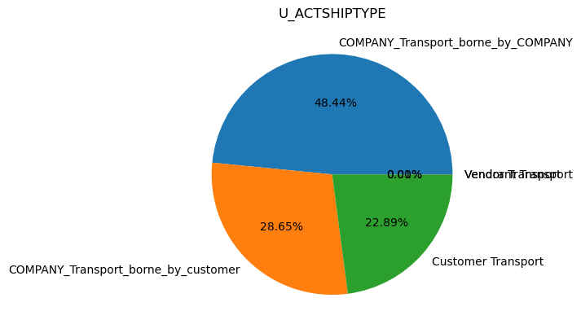
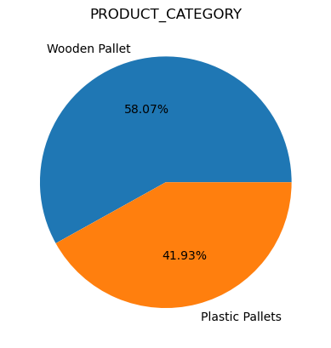
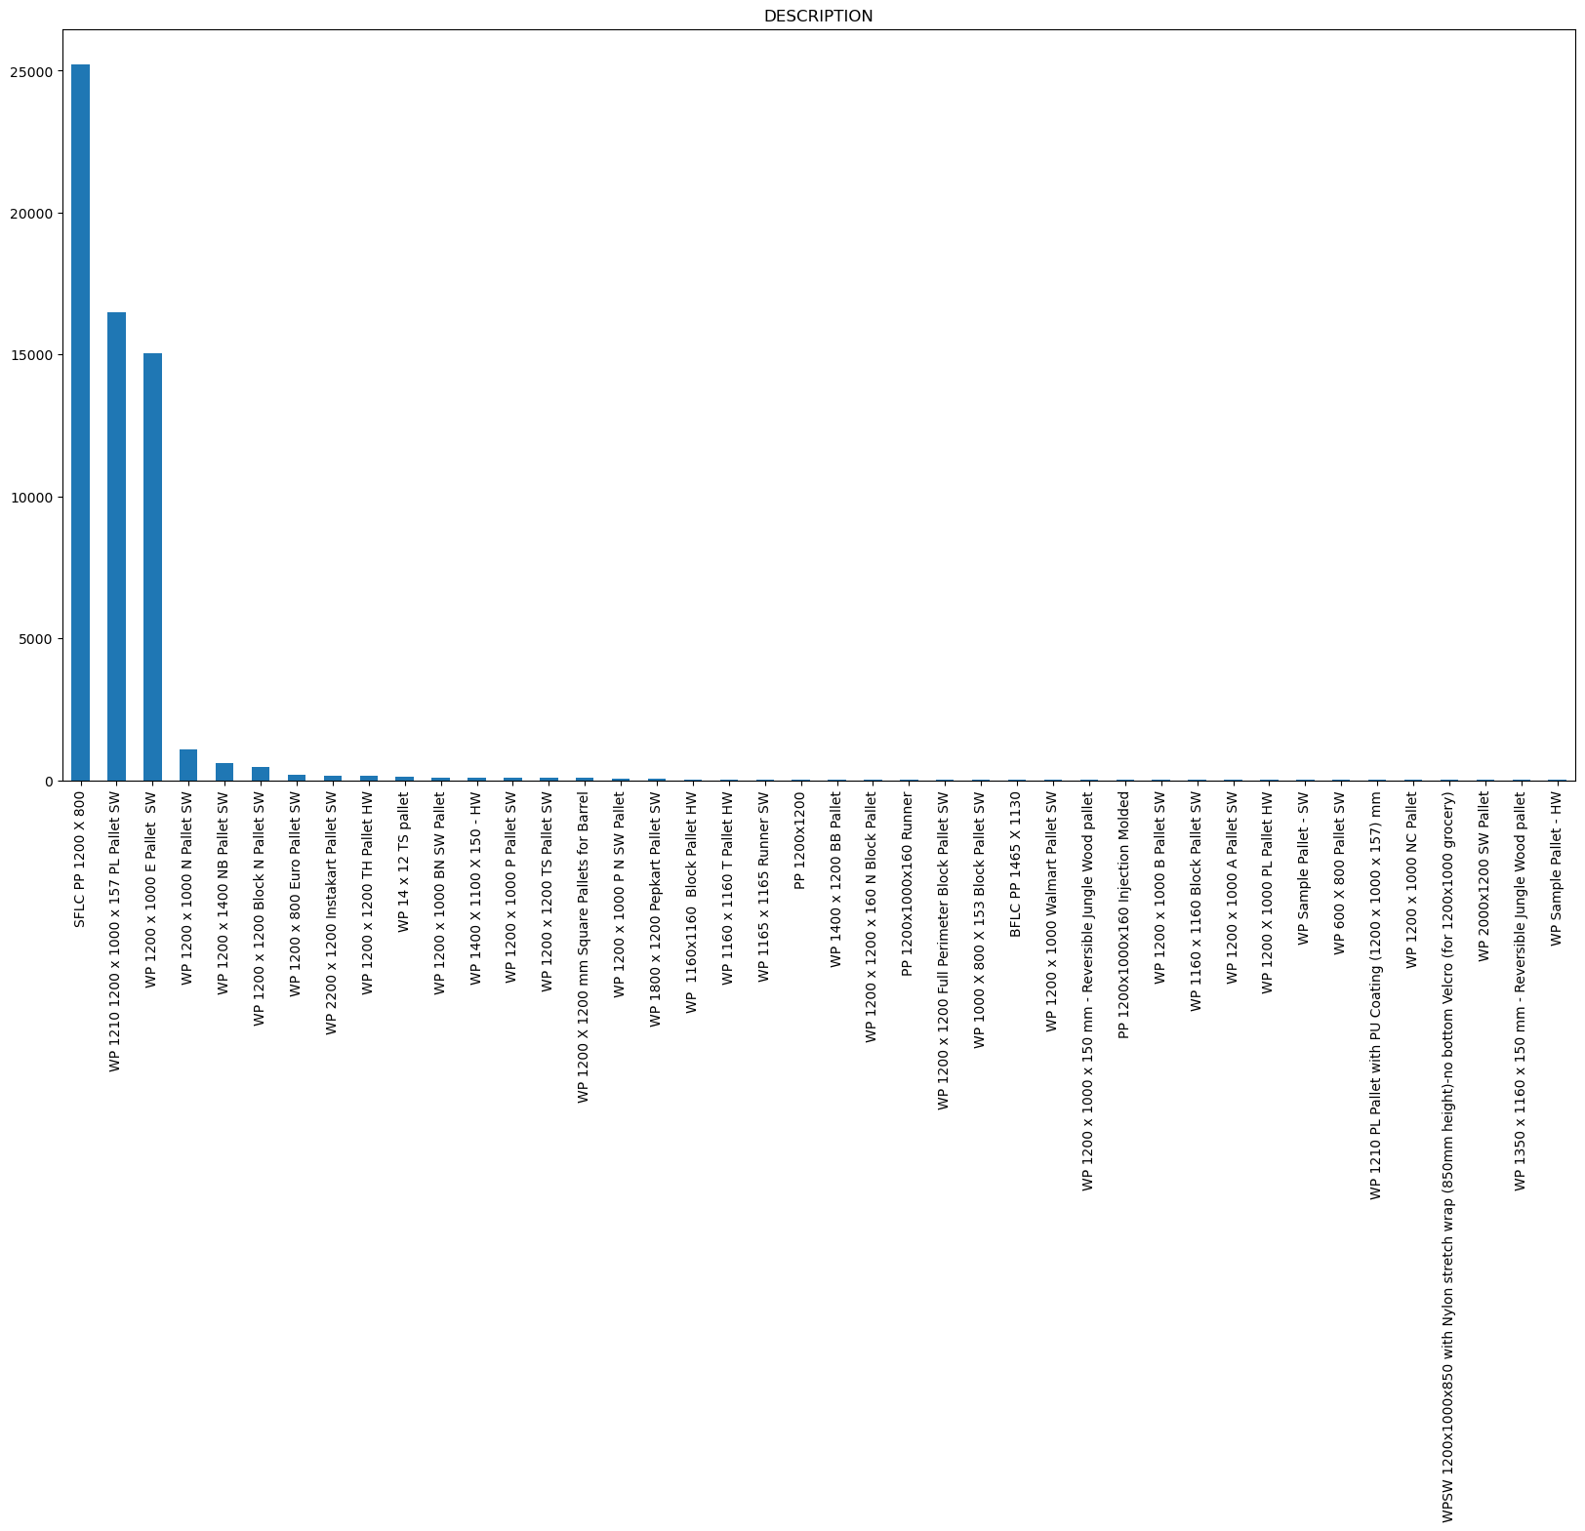
Data Visualization- EDA FOR ALLOT
Notes:
Piee

Slide 24
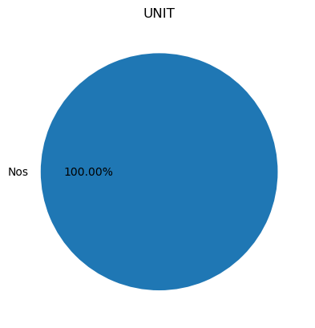
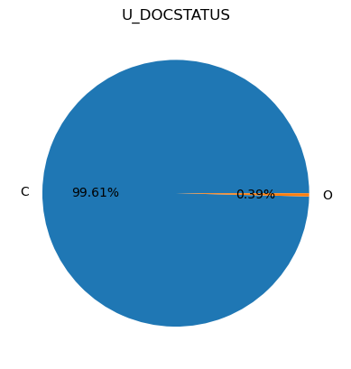
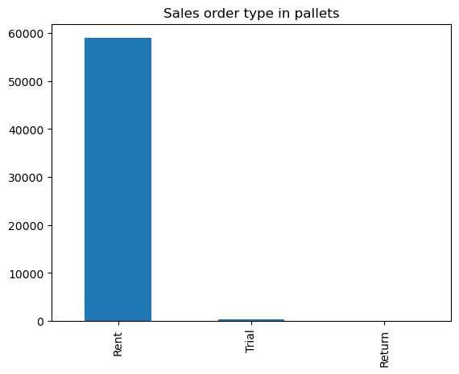
Data Visualization-EDA FOR ALLOT
Notes:
Piee

Slide 25
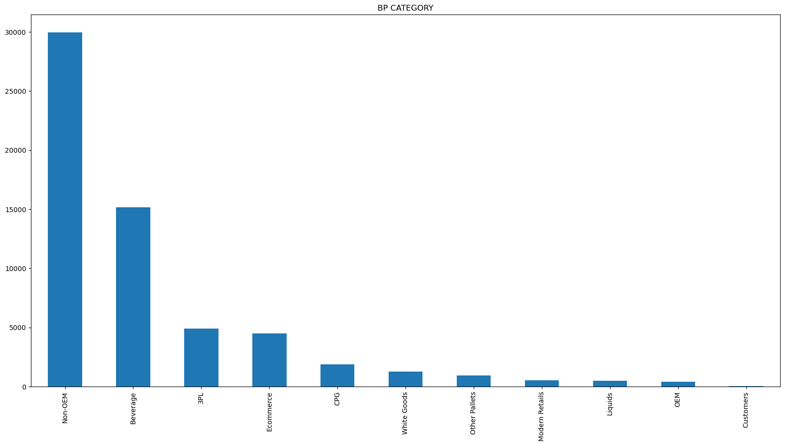
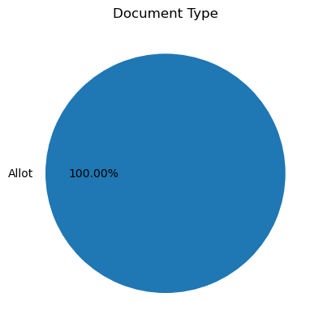
EDA FOR ALLOT
Notes:
classification is the task of predicting a discrete class label. Regression is the task of predicting a continuous quantity.
What is classification techniques in machine learning?
The Classification algorithm is a Supervised Learning technique that is used to identify the category of new observations on the basis of training data. In Classification, a program learns from the given dataset or observations and then classifies new observation into several classes or groups.
What is regression techniques in machine learning?
Regression is a technique for investigating the relationship between independent variables or features and a dependent variable or outcome. It's used as a method for predictive modeling in machine learning, in which an algorithm is used to predict continuous outcomes.

Slide 26
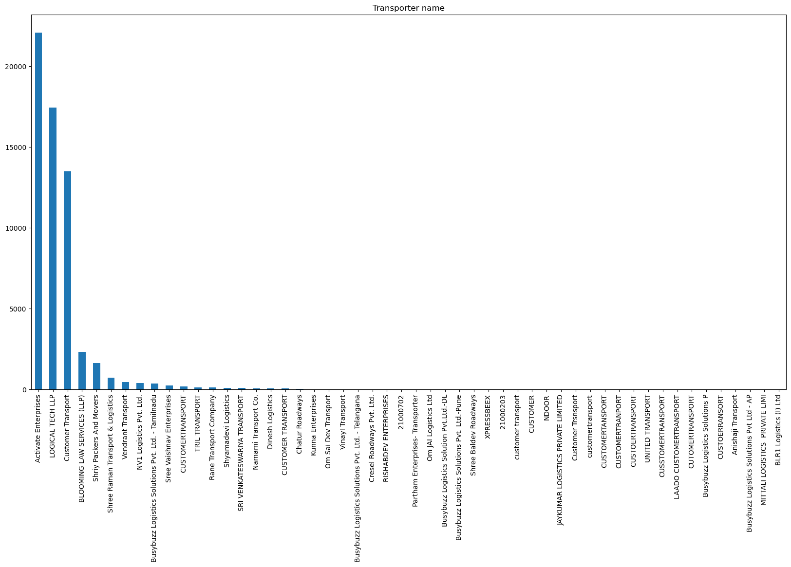
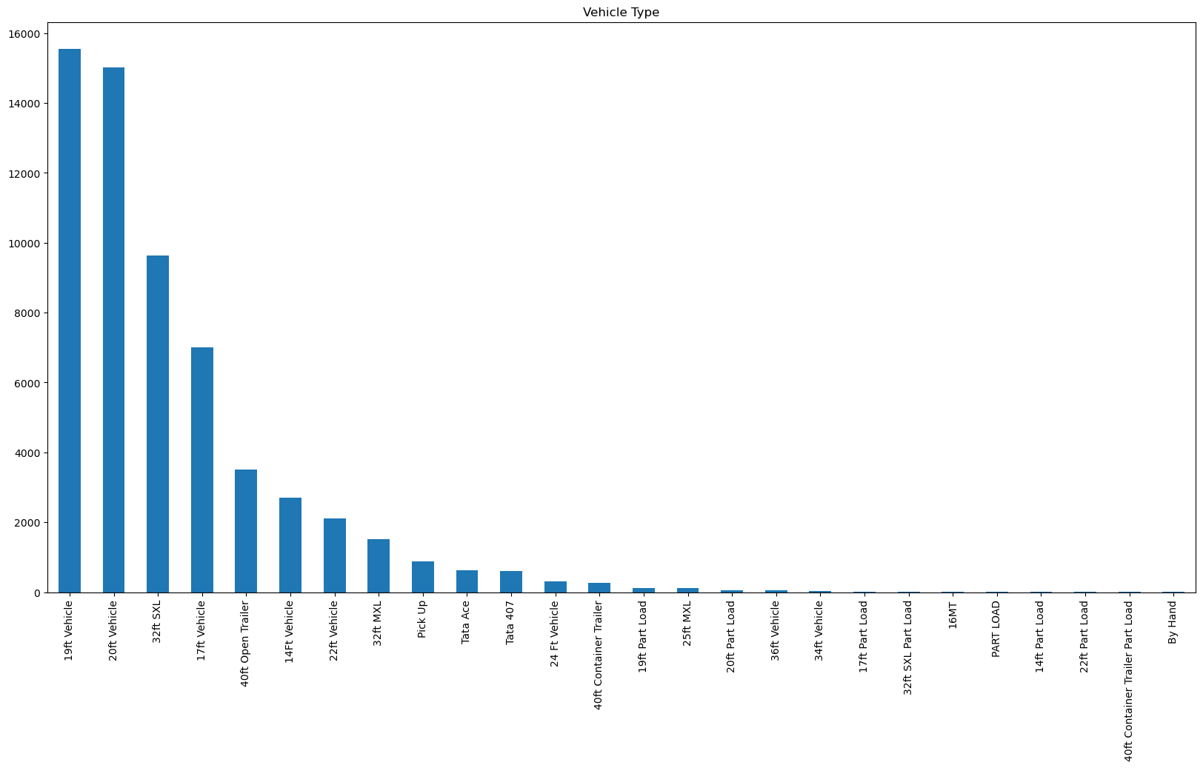
EDA FOR ALLOT
Notes:
What is the role of regression in ML
Is regression supervised or unsupervised?

Slide 27
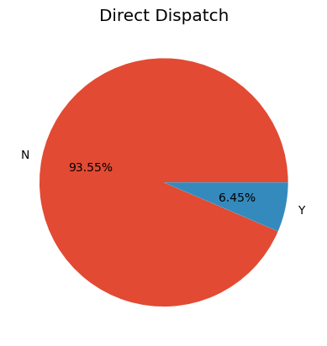
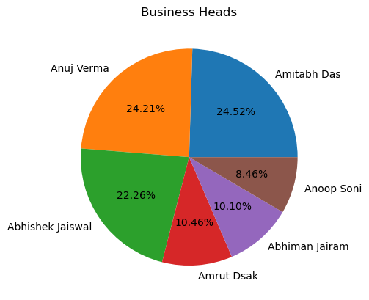
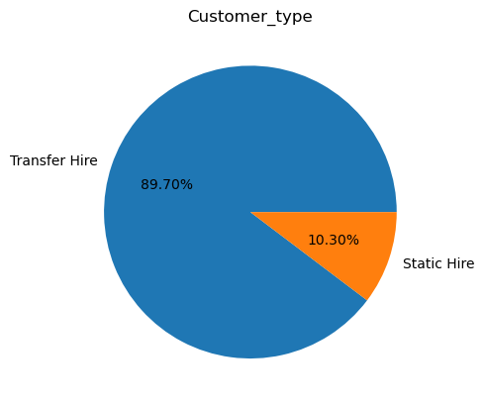
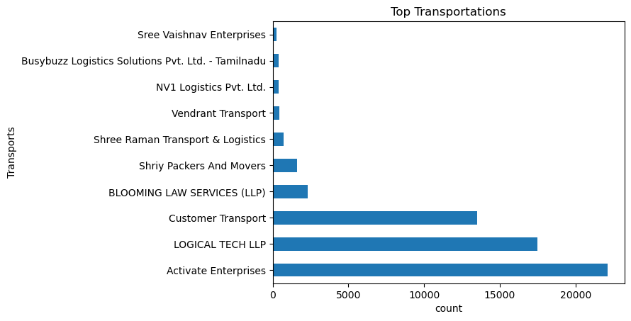
EDA FOR ALLOT

Slide 28
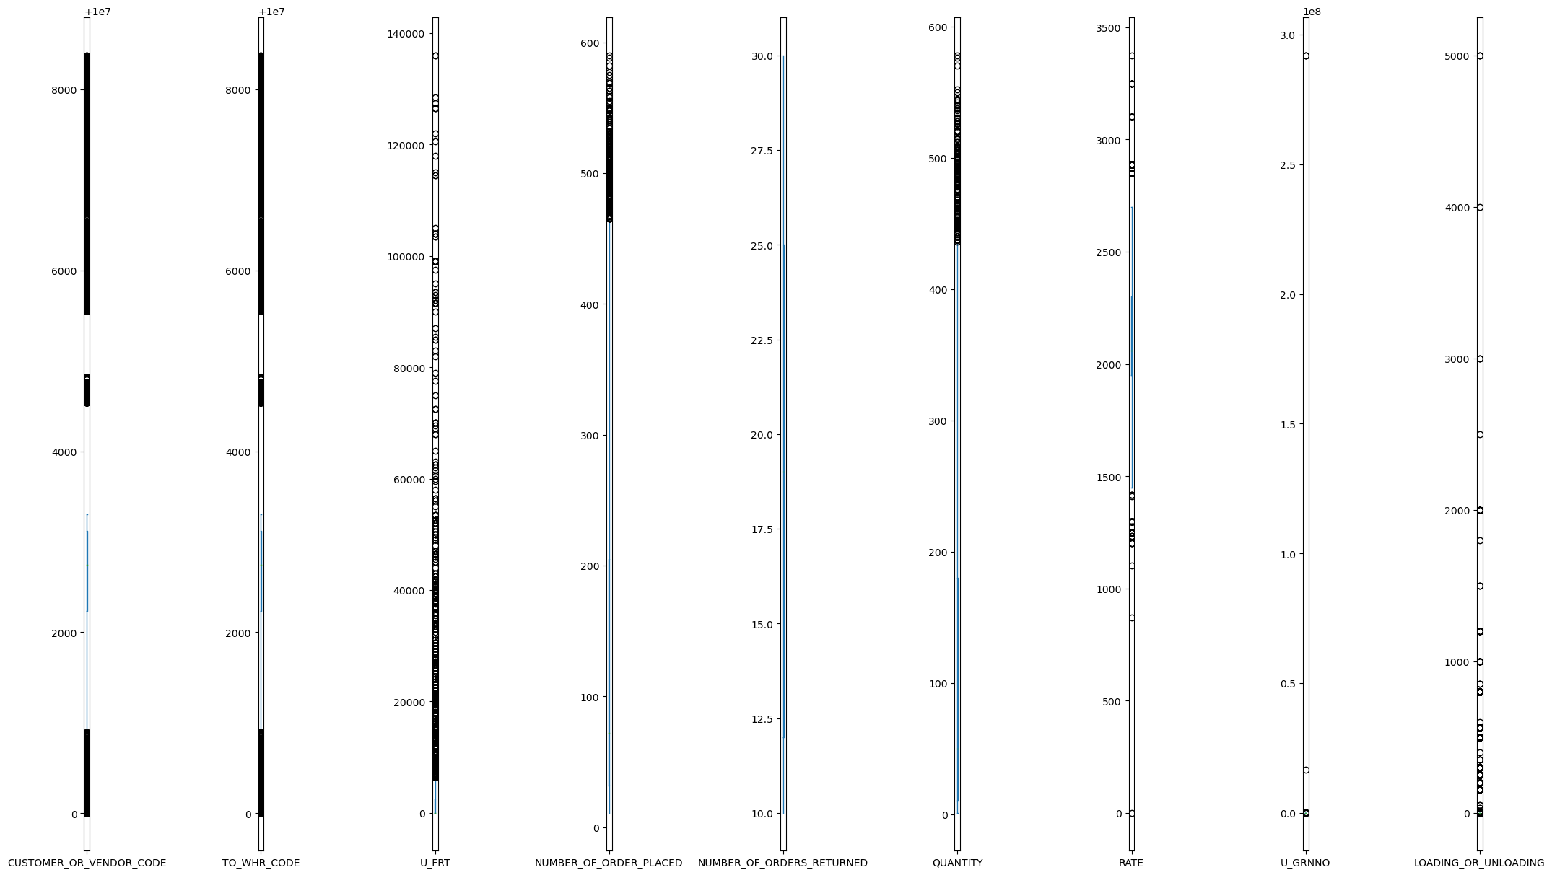
Outliers in allot

Slide 29
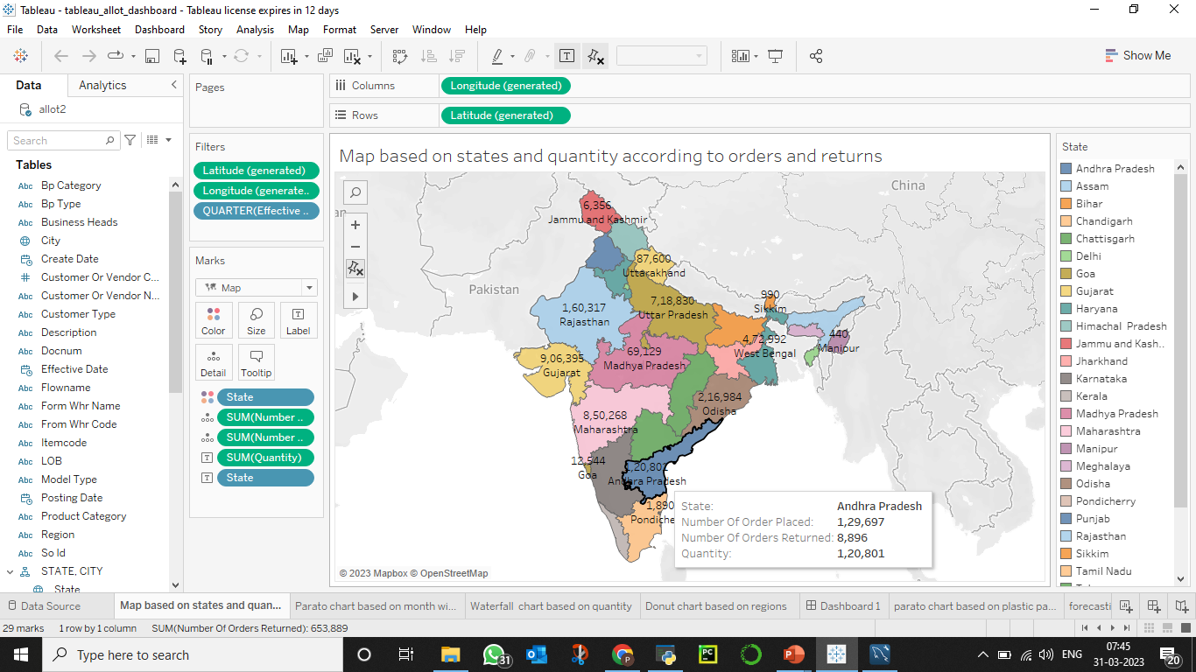
VISUALIZATION IN TABLEAU- Map based on quantity and states in allot
Notes:
Why Random Forest Regression is good?
A Random Forest Regression model is powerful and accurate. It usually performs great on many problems, including features with non-linear relationships
How is XGBoost different from random forest?
One of the most important differences between XG Boost and Random forest is that the XGBoost always gives more importance to functional space when reducing the cost of a model while Random Forest tries to give more preferences to hyperparameters to optimize the model..
n_estimators — the number of decision trees you will be running in the model

Slide 30
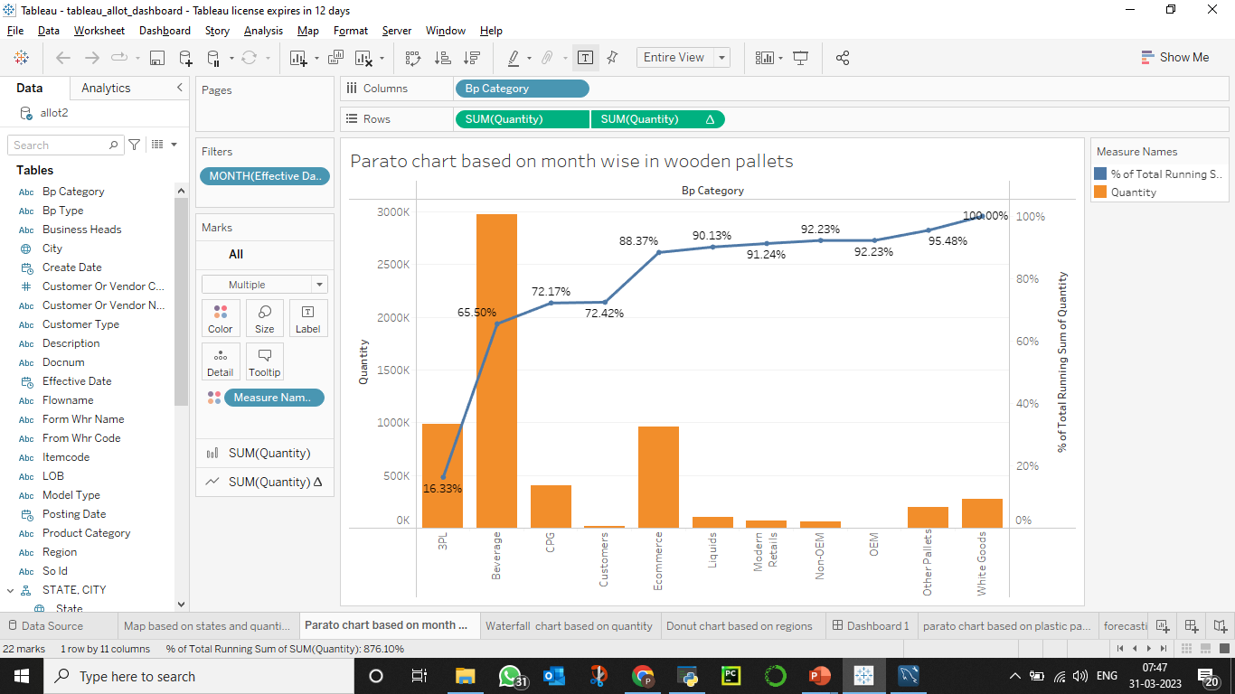
Parato chart based on wooden pallets

Slide 31
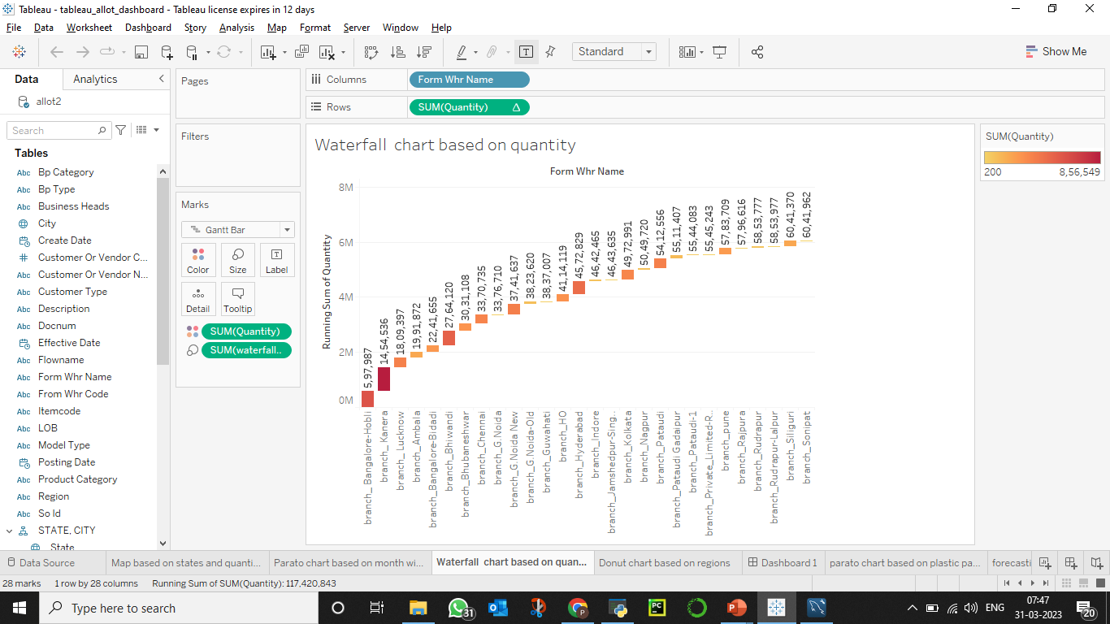
Waterfall chart based on quantity

Slide 32
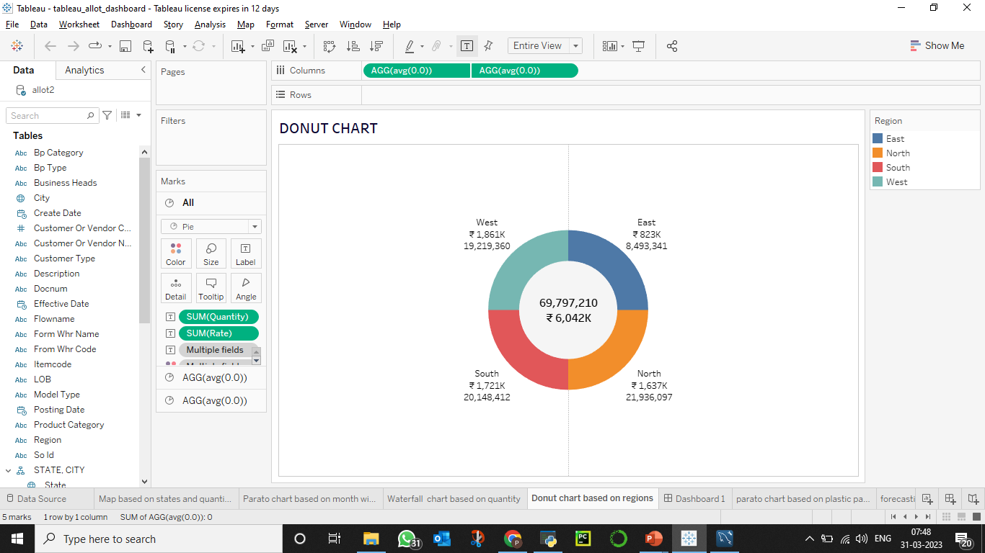
Donut chart based on quantity and rate

Slide 33
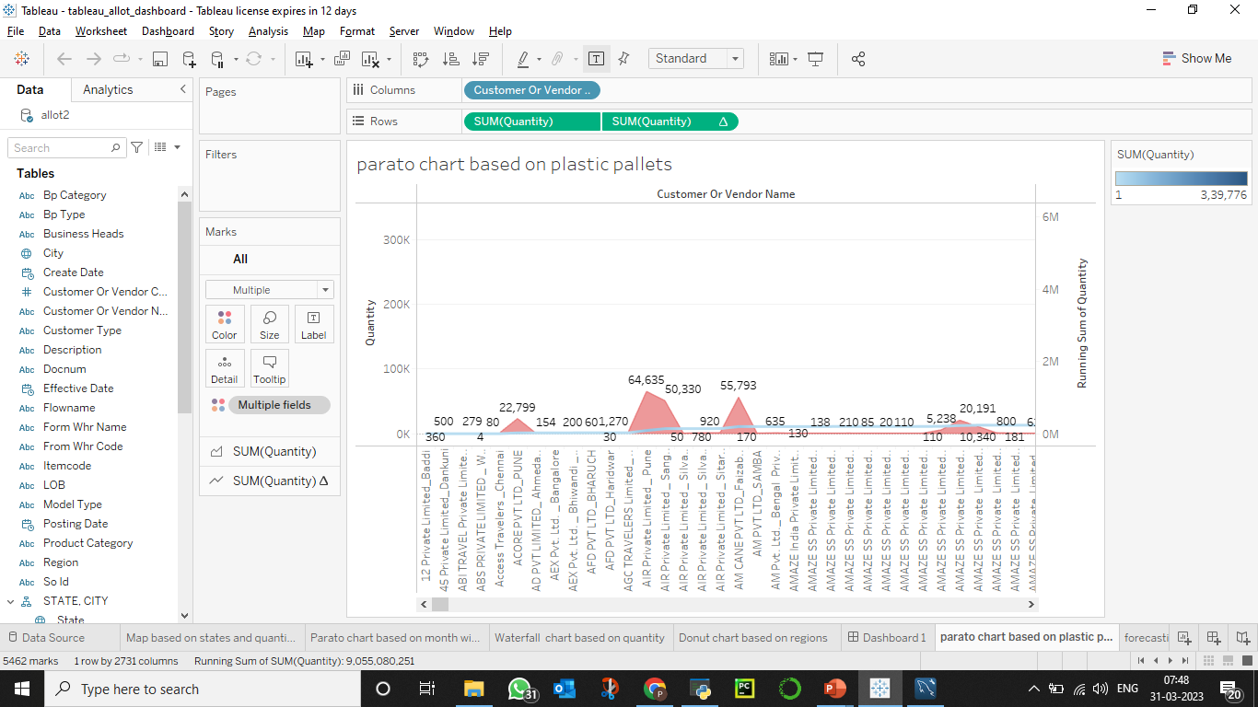
Parato chart based on plastic pallets

Slide 34
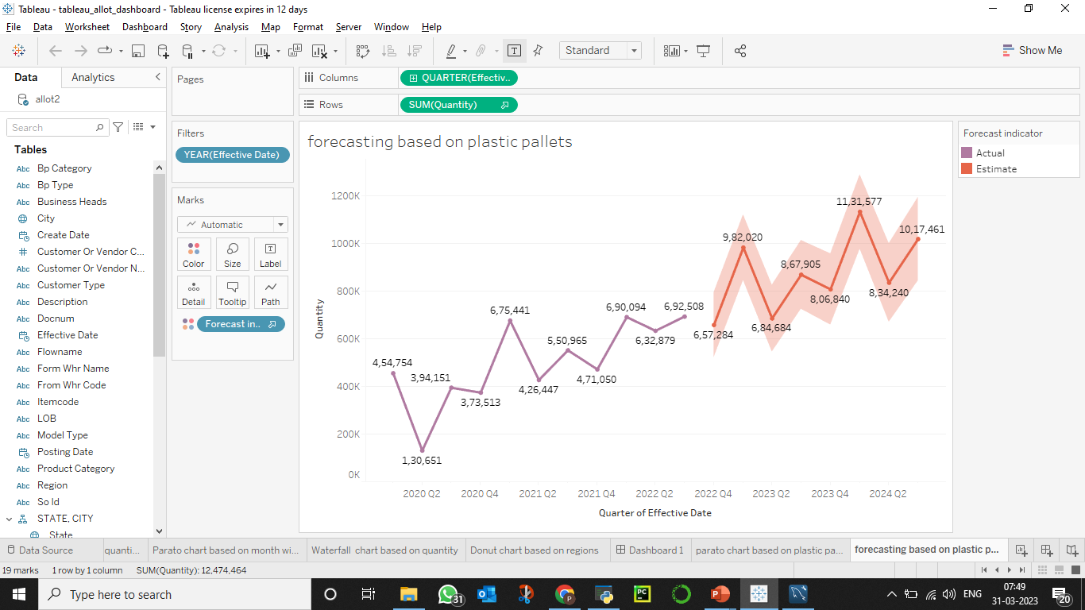
Forecasting based on plastic pallets

Slide 35
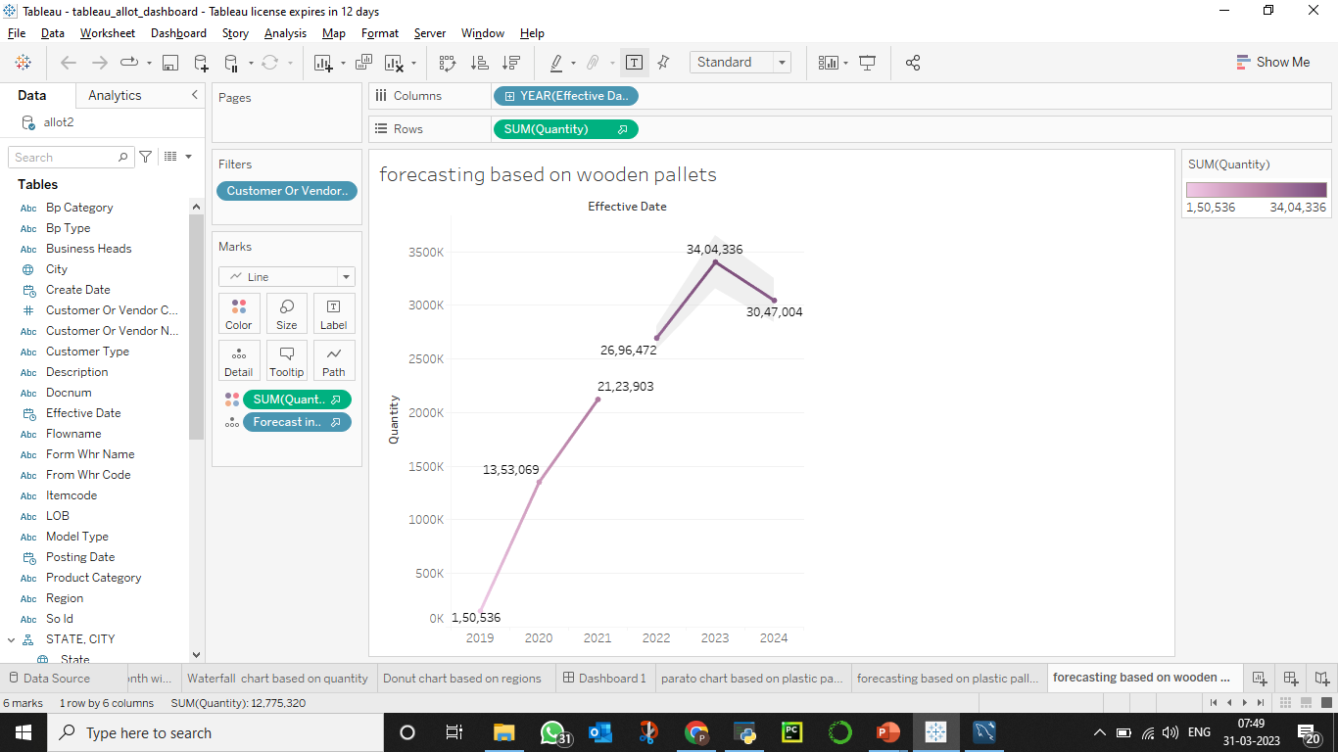
Forecasting based on wooden pallets

Slide 36
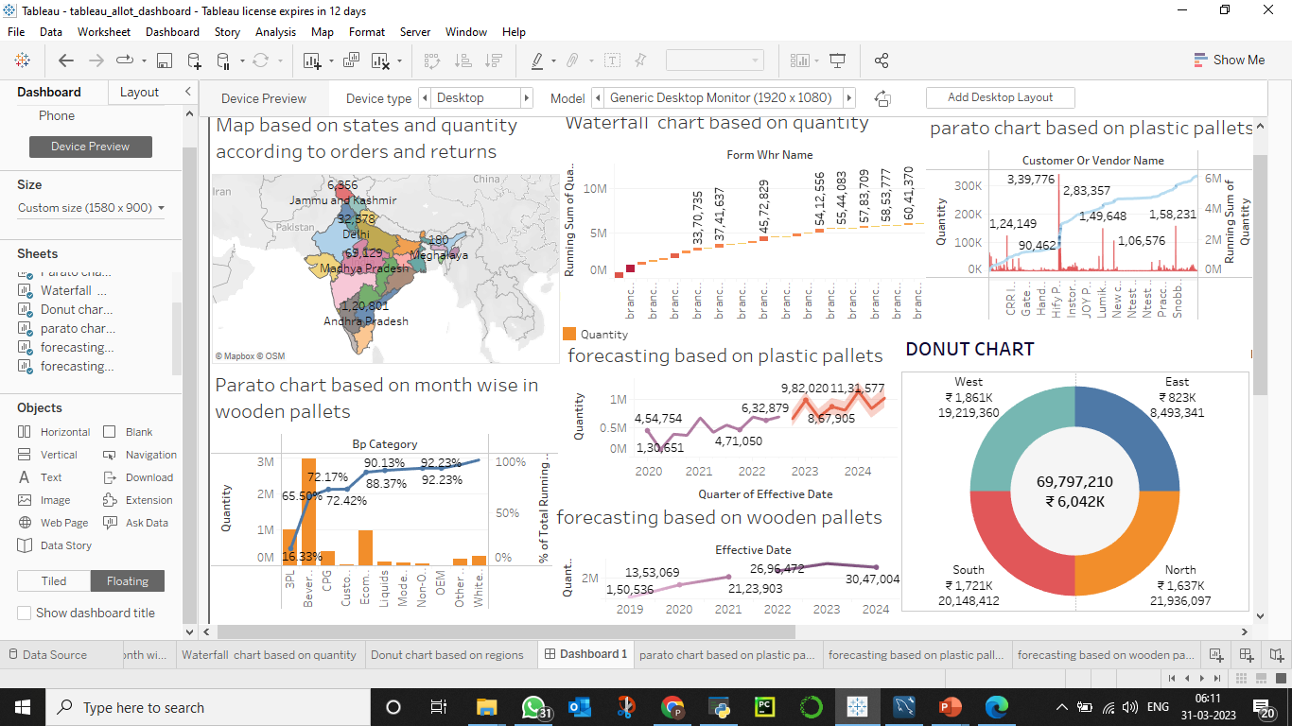
Dashboard for allot

Slide 37
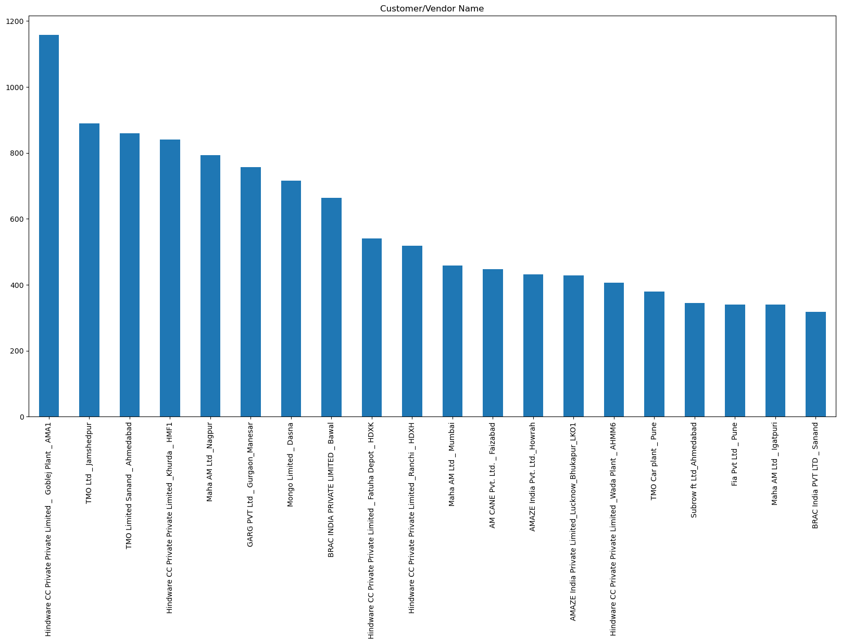
EDA PART FOR DEHIRE

Slide 38
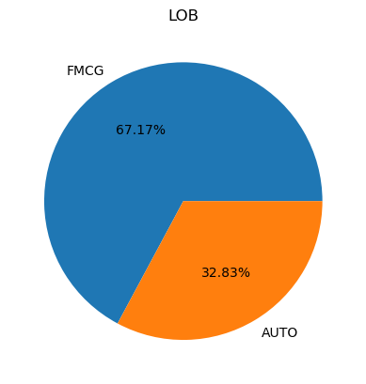
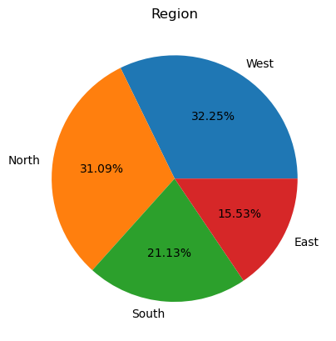

Pie chart for LOB,region,BP type

Slide 39
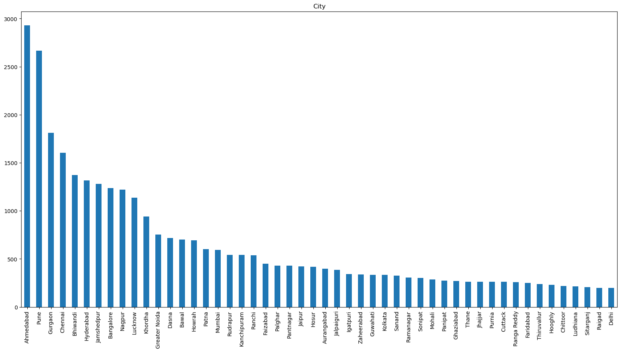
city

Slide 40
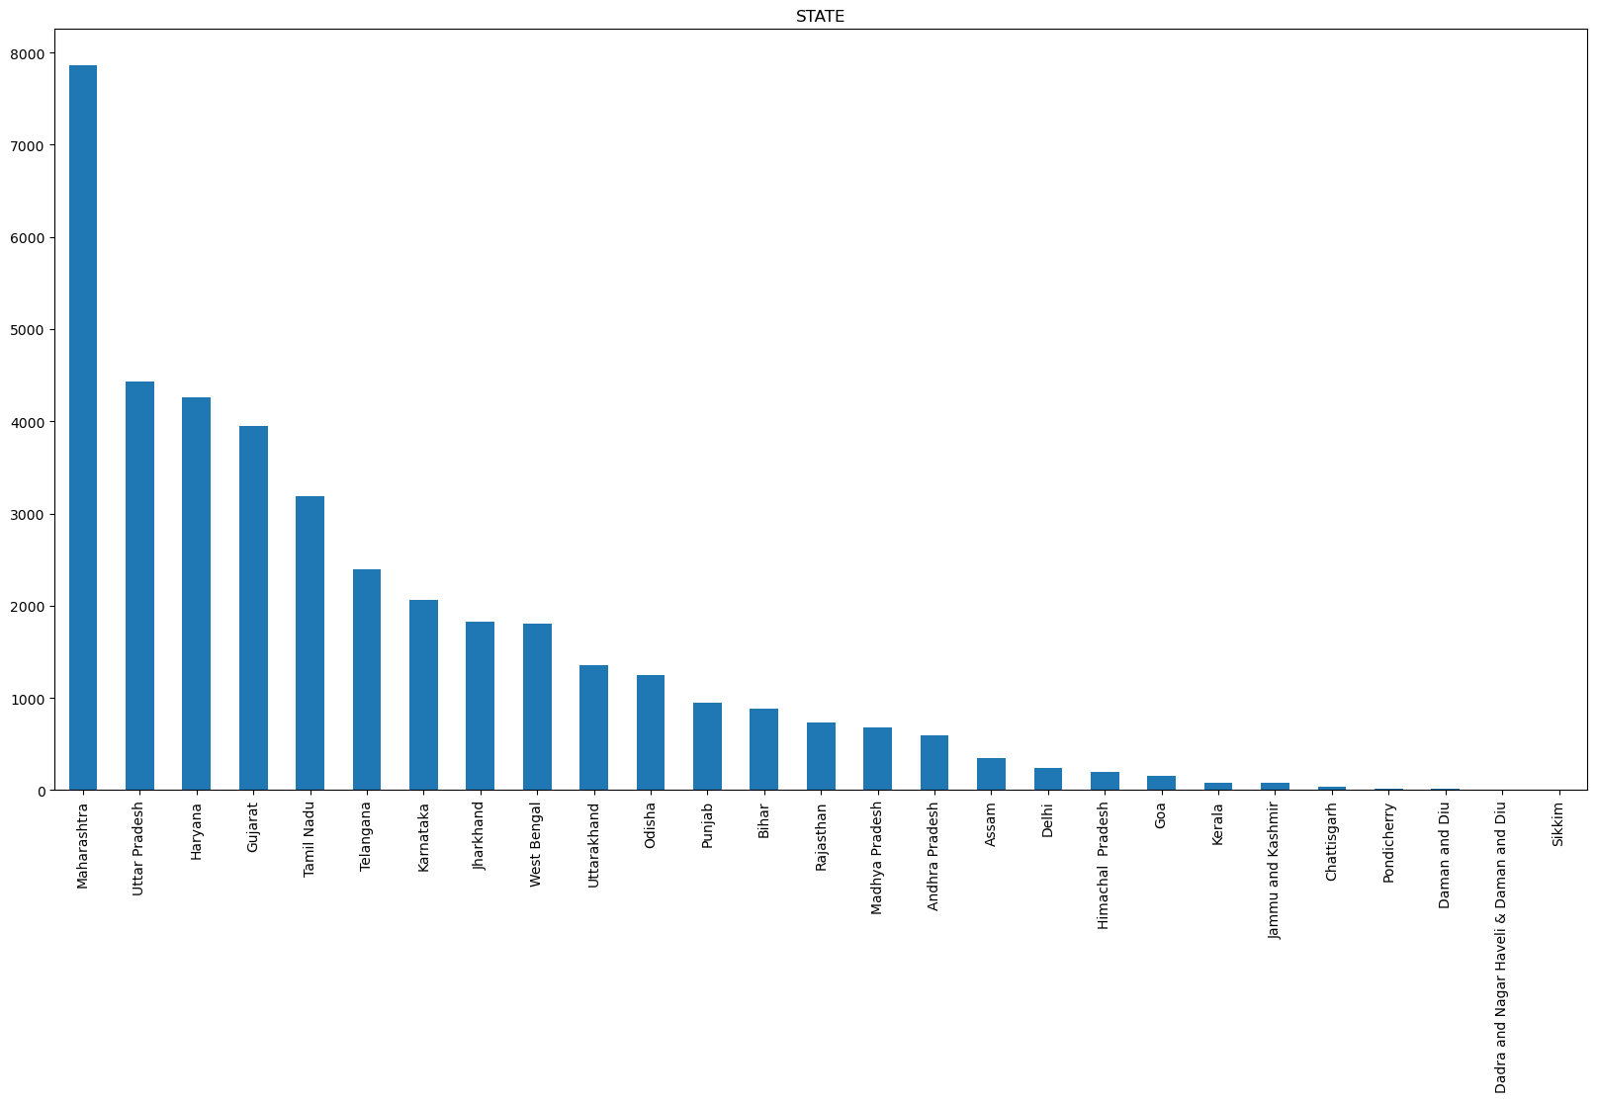
State

Slide 41
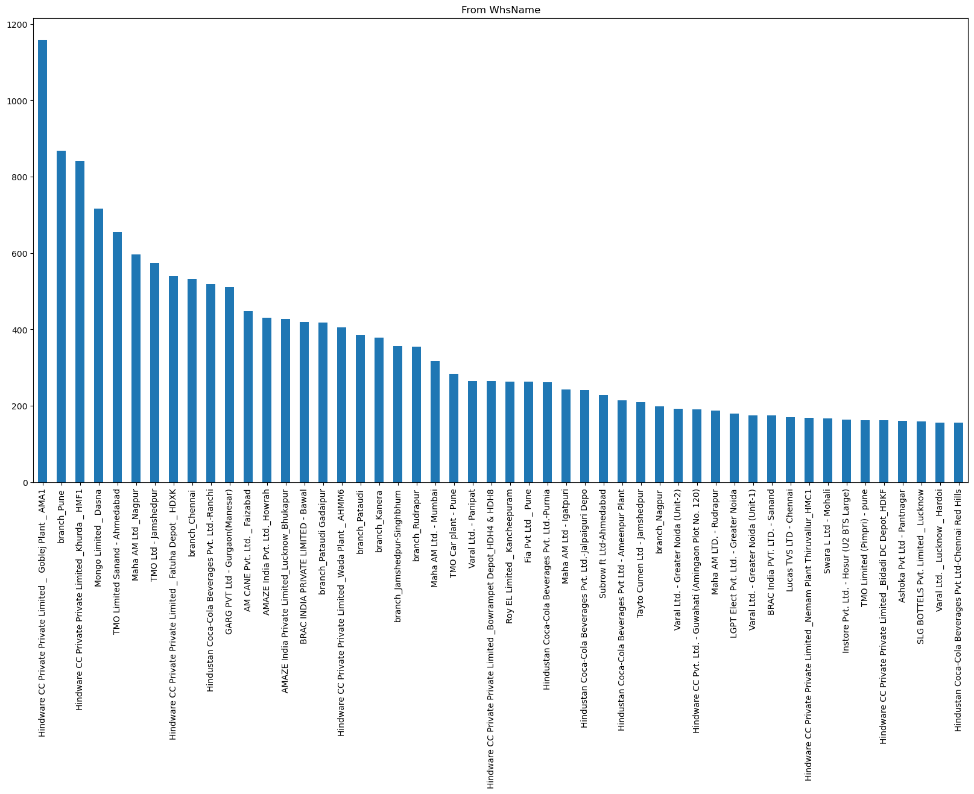
From wharehousename

Slide 42
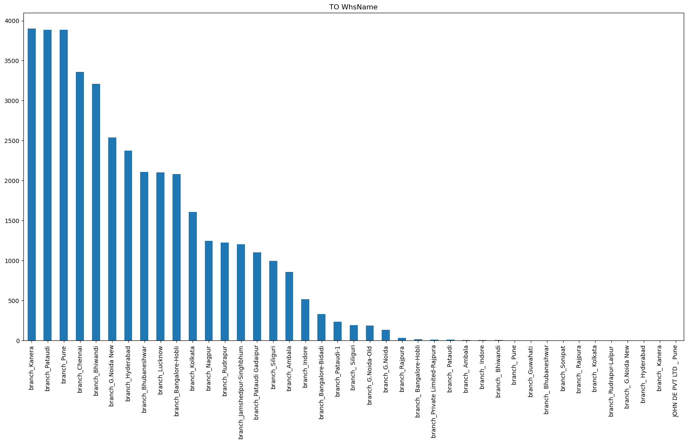
To- Wharehousename

Slide 43
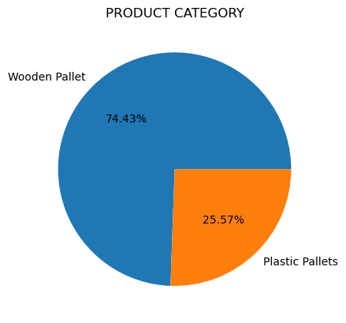
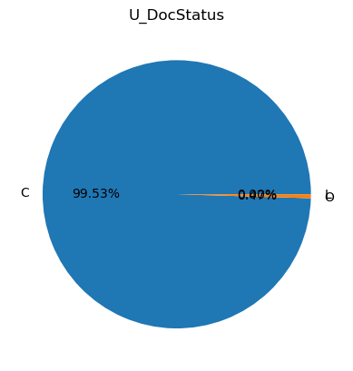
Pie chart for product category,unit and U_Docstatus

Slide 44
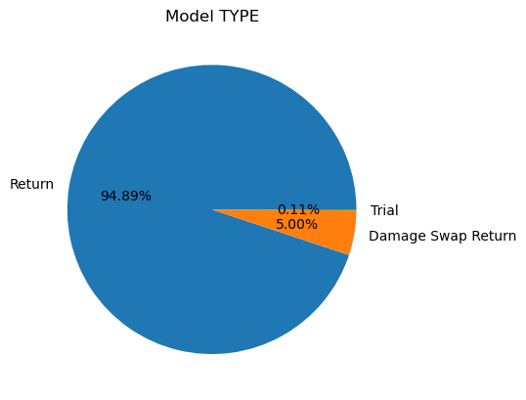
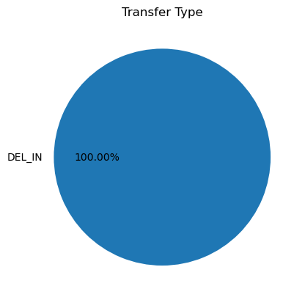
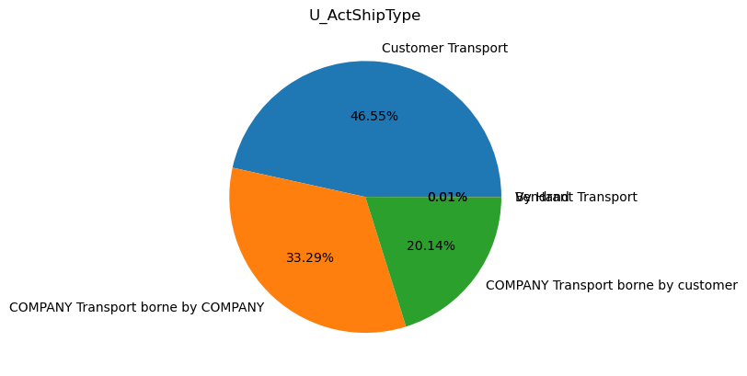
Pie chart for model type, transfer type,U_Actshiptype

Slide 45
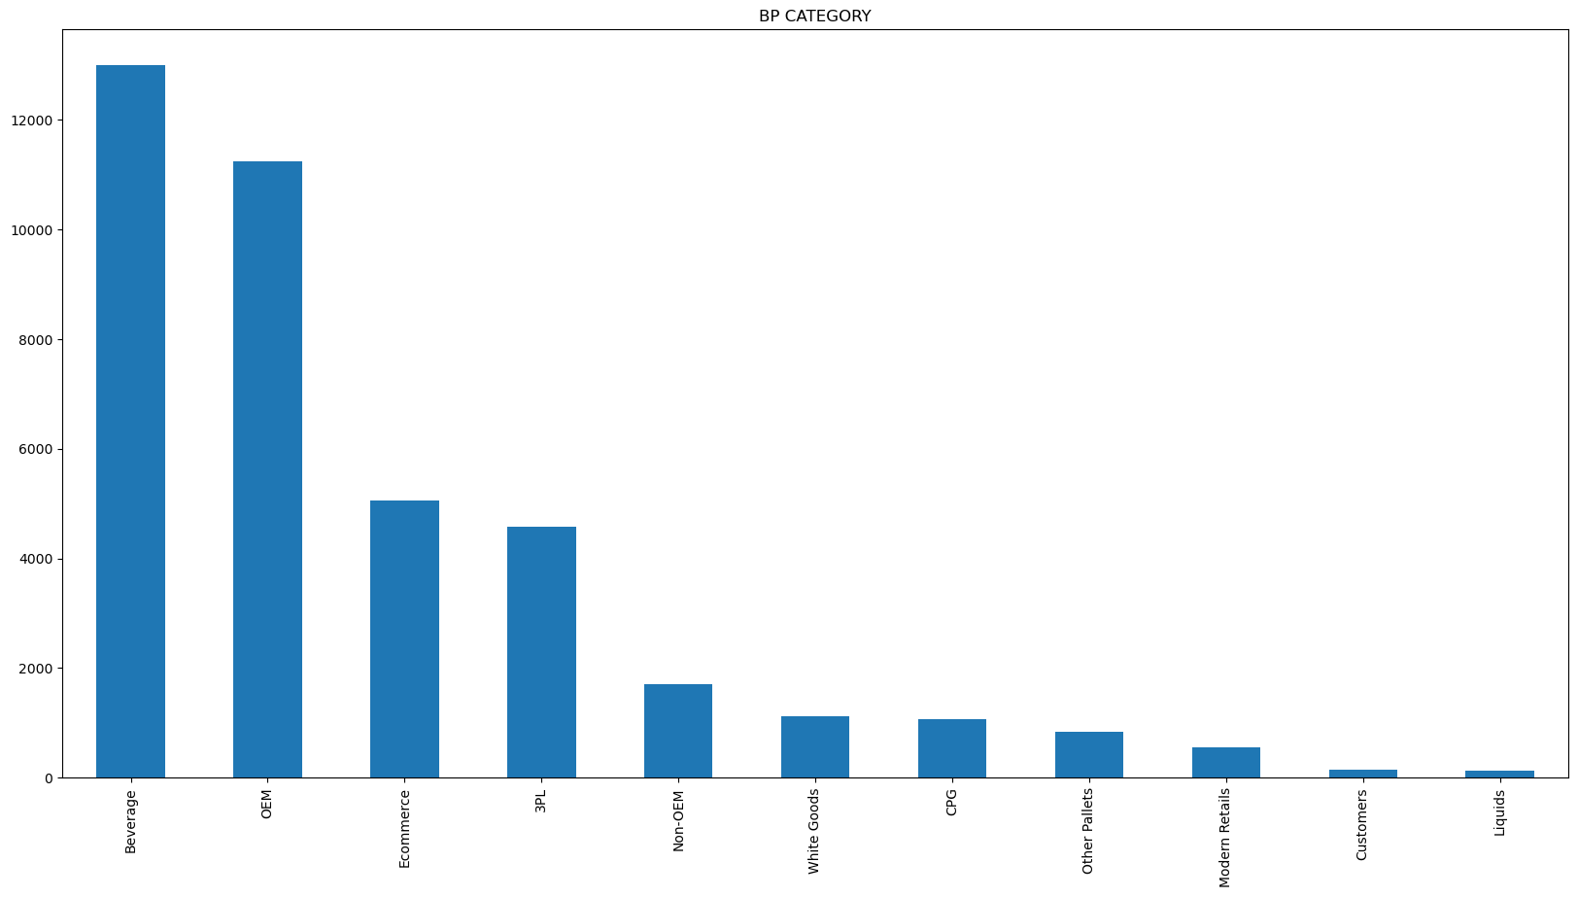
Dehire-BP CATEGORY

Slide 46


Pie chart for document type and direct dispatch

Slide 47


Dehire-Transportor name and vehicle type

Slide 48


Dehire-loading/unloading and Detension

Slide 49



Pie- chart for business heads ,U_Assertclass and customer type

Slide 50

Dehire-flowname

Slide 51

VISUALIZATION IN TABLEAU- Map based on quantity and states in allot

Slide 52

Forecasting for plastic pallets for next 2 years

Slide 53

Map for city wise in quantity

Slide 54

Pareto charts for plastic pallets

Slide 55

Pareto chart for wooden pallets

Slide 56

Dashboard

Slide 57


Slide 58

Queries ?

Slide 59


